Slide 1
Organization Visiting: LAFArGEHOLCIM bangladesh LTD.
Course Name: Business Studies for Engineers
Course Code: BUS 405
Supervised by-
Mr. Md. Iftekharul Amin
Assistant Professor
Institute of Business Administration
University Of Dhaka

Slide 2
Presented by
Group-02
Ibrahim Khalil BSSE0804
Toukir Ahammed BSSE0806
Mahir Mahbub BSSE0807

Slide 3
Presentation Outline
Aim of the visit
About the Organization
Hierarchical Structure
Recruitment System
Culture of the Organization

Slide 4
Aim of the Visit
To know about the organizational culture
Know about the structure of an organization
Get an idea about the relationship between manager and employees
Know about environment of an organization

Slide 5

About the Organization: LAFARGEHolcim BD LTD.
LafargeHolcim is a joint venture company founded in 2015
It operates in 80 countries.
It is the only cement company in Bangladesh who uses their own clinker as well as supplies clinker to other company

Slide 6
Vision and Values: LAFARGEHolcim BD LTD.
Vision : The Financial Supermarket with a Winning Culture Offering Enjoyable Experiences
Values :
Customer and Solution Centric
Excellence
Innovate to differentiate
Engaged & Inspired
Focused on Customer Delight

Slide 7
Organizational Structure: LAFARGEHolcim BD LTD.
The Company manages its business and operation vertically from the head office through 5 distinct Units namely
Finance and Accounts
HR
Marketing
Sales Administration
Information Technology

Slide 8
Managerial Hierarchy (management level)
Chief Executive Officer
Executive Assistant
Finance Director
Sales Director
Marketing Director
Supply Chain Director
HR Director
SVP Operations
VP & Director, LUMPL
Chief Executive Officer
Company Secretary and Legal
Head of Health and Safety
Head of Strategy and Planning
Head of Internal Audit
Head of Communications
Head of Risk Management and Administrations

Slide 9
Recruitment System
Eligible applicants are interviewed
Successful applicants are sent offer letters
Offer letter contains all the terms of employment and organizational regulations
LafargeHolcim is seeking to recruit, develop, and retain the best talent to help us meet the challenges and opportunities of the future
Read more: http://www.lafargeholcim.com/careers#ixzz4wMI9kCvW Follow on: @LafargeHolcim on Twitter | LafargeHolcim on Facebook

Slide 10
Orienting new employees
All new employees must go through a nurturing program about 5-10 month before appointing them permanently.
Current employees of the department are encouraged to hold informal workplace related discussions with new employees on topics such as goal, vision and history of the company
After such nurturing program ,employees are appointed to various positions and departments

Slide 11
Culture of the Organization
A healthy and safe work environment
Expressing gratitude for work done is highly encouraged
An inclusive, caring, and enjoyable workplace
Connecting the best talents and Opportunities to grow to full potential
All tasks must be approved by immediate line manager
Recognize and reward contributions
Review: https://www.indeed.com/cmp/Lafargeholcim/reviews?ftopic=culture

Slide 12
Culture of the Organization
Employee performance is evaluated monthly and annually using PMP (performance measuring process)
If the head of a department leaves, the employee next in line in the organizational hierarchy work as the acting head of that department and is instated permanently if his next annual PMP score is satisfactory
Review: https://www.indeed.com/cmp/Lafargeholcim/reviews?ftopic=culture

Slide 13
Culture of the Organization
Board of Directors have the final say in strategic decisions of the organization
Policies have been known to change based on feedback collected from employees, customers and beneficiaries
Review: https://www.indeed.com/cmp/Lafargeholcim/reviews?ftopic=culture

Slide 14
Informal Culture of the Organization
There exists a friendly relationship among all the employees
Birthday of any employee is celebrated with so much enthusiasm
Employees who have got promotion usually take their colleagues to lunch or dinner
Every year each department organizes picnic with the employees and their family members
Several sport event like cricket, football or badminton have been organized throughout the year

Slide 15
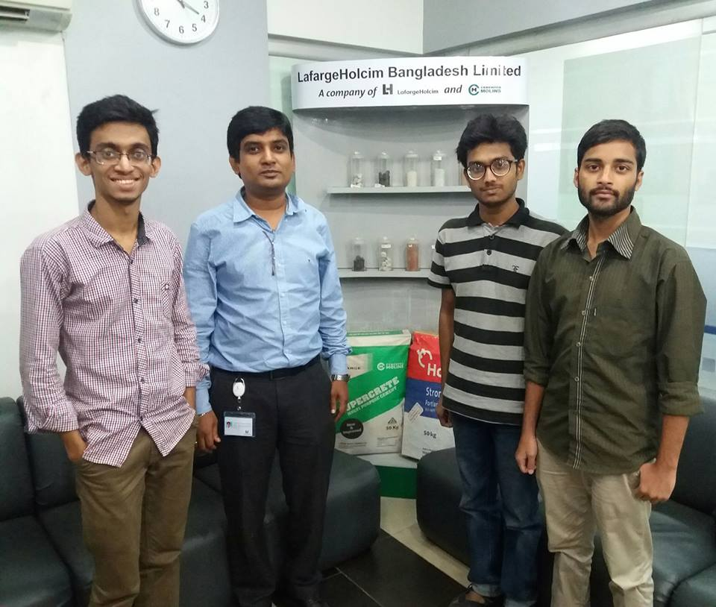
Thanks to Md. Mazharul Huda Lizan, Manager- Logistics Cost Control, LHBC.

Slide 16
Thank You!

